Slide 2
Digital Forensics Lecture-19
By- Dr.subhranil Das
Assistant Professor
School of computer Science

Slide 3

Digital Evidence in Windows Systems
Given the popularity of Microsoft Windows, digital investigators will encounter these systems as sources of digital evidence in the majority of cases.
As a result of its prevalence, powerful commercial forensic tools have been developed to facilitate the forensic examination of Windows systems.
Understanding file systems helps appreciate how information is arranged, giving insight into where it can be hidden on a Windows system and how it can be recovered and analyzed

Slide 4
File Systems
The simplest Windows file systems to understand are the FAT (file allocation table) file systems: FAT12, FAT16, and FAT32.
Although relatively old, FAT file systems are still used on many storage systems such as removable storage media in digital cameras and mobile devices.
FAT file systems are a good starting point for forensic analysts to understand file systems and recovery of deleted data.

Slide 5
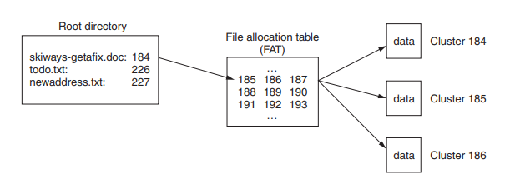
Root directory

Slide 6
What is FAT?
A FAT formatted volume uses directories and a file allocation table to organize files and folders.
The root folder (e.g., C:\) is at a pre-specified location on the volume so that the operating system knows where to find it.
This folder contains a list of files and subdirectories on a floppy diskette with their associated properties through X-Ways Forensics.

Slide 7
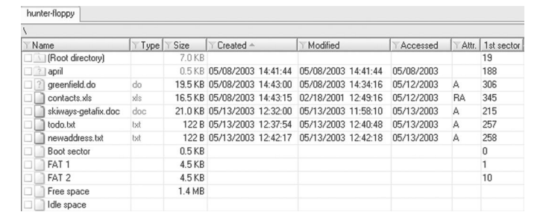
Root directory of floppy diskette viewed using X-Ways Forensics
This view of the folder shows the starting cluster and date-time stamps associated with each file.
Notably, FAT file systems do not record the last accessed time, but only the last accessed date.
The FAT can be thought of as a list with one entry for each cluster in a volume.
Each entry in the FAT indicates the associated cluster is being used for

Slide 8
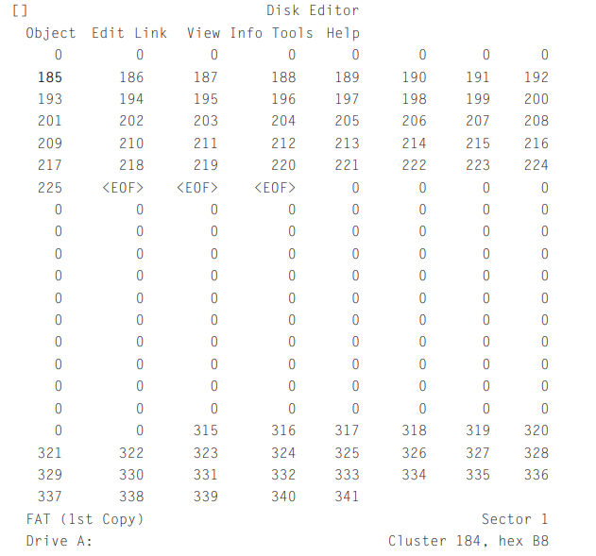
Output from Norton Disk Editor
Clusters containing a zero are those free for allocation (e.g., when a file is deleted, the corresponding entry in the FAT is set to zero).
If a FAT entry is greater than zero, this is the number of the next cluster for a given file or folder.
The root folder indicates that file “skyways-getafix.doc” begins at cluster 184.
The associated FAT entry for cluster 184 indicates that the file is continued in cluster 185.
The FAT entry for cluster 185 indicates that the file is continued in cluster 186, and so on (like links in a chain) until the end-of-file (EOF) marker in cluster 225 is reached.

Slide 9
Subdirectories
Subdirectories are just a special type of file containing information such as names, attributes, dates, times, sizes, and the first cluster of each file on the system.
For instance, before the folder named “april” on the floppy diskette was deleted and overwritten, it has occupied cluster 157.
When an individual instructs a computer to open a file in a subfolder (e.g., “C:\april\handbright.doc”), the operating system goes to the root folder,
Determines which cluster contains the desired subfolder (cluster 157 for “april”), and uses the folder information in that cluster to determine the starting cluster of the desired file (cluster 79 for “handbright.doc”).

Slide 10
Features of FAT file
FAT12 uses 12-bit fields for each entry in the FAT and is mainly used on floppy diskettes.
FAT16 uses 16-bit fields to identify a particular cluster in the FAT and there must be fewer than 65,525 clusters on a FAT16 volume.
This is why larger clusters are needed on larger volumes—a 1-GB volume can be fully utilized with 65,525 16-kB clusters (32 sectors per cluster), whereas a 2-GB volume requires clusters that are twice as big: that is, 65,525 32-kB clusters (64 sectors per cluster).
FAT32 was created to deal with larger hard drives by using 28-bit fields in the FAT (4 bits of the 32-bit fields are “reserved”).
FAT32 also makes better use of space, by using smaller cluster sizes than FAT16—this can be a disadvantage for investigators because it can reduce the amount of slack space

Slide 11
NTFS
NTFS is significantly different from FAT, storing file system information in several system files including a Master File Table (named $MFT).
Supporting larger disks more efficiently (resulting in less slack space)
Provides file and folder level security using Access Control Lists (ACLs).
NTFS is designed with disaster recovery in mind, storing a copy of the $BOOT system file at both the beginning and end of the volume.
In addition, a copy of the first four records in the $MFT file is stored in another system file named $MFTMIRR located in the middle of the volume.
These copies of information can be useful from a forensic perspective when attempting to recover files.

Slide 12
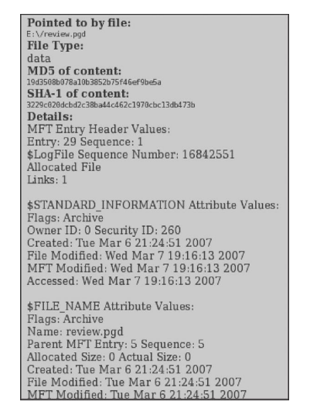
NTFS
The $MFT contains a list of records, each 1024 bytes in length, that store most of the information needed to locate data on the disk.
Each entry in the $MFT represents a file or folder, and stores associated attributes including $STANDARD_INFORMATION. and $DATA.
The $STANDARD_INFORMATION attribute stores the created, last modified, and last accessed dates and times.
The $DATA attribute either contains the actual file contents of small files (called resident files) or the location on disk of large files (non-resident files)

Slide 13
2 concepts in NTFS
In NTFS, there are two important concepts of file length: the End of File (EOF) marker and the Valid Data Length (VDL).
The EOF indicates the actual length of the file.
The VDL identifies the length of valid data on disk. Any reads between VDL and EOF automatically return 0 in order to preserve the C2 object reuse requirement (Microsoft fsutil documentation).
The space between the end of valid data and the end of file is called uninitialized space.
Uninitialized space is similar in concept to file slack except that it is contained within the logical file size.

Slide 14
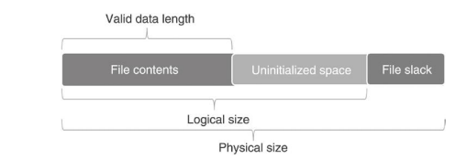
Diagram of file with a logical size

Slide 15
MFT entry with logical size and valid data length viewed using X-Ways Forensics
The effects of file initialization behaviors are most easily demonstrated on Windows XP with fsutil as shown here. First, we create a new file that can contain 1024 bytes.
Then we set the valid data length of the new file to 1000 bytes, which leaves 24 bytes unused at the end of the file.

Slide 16
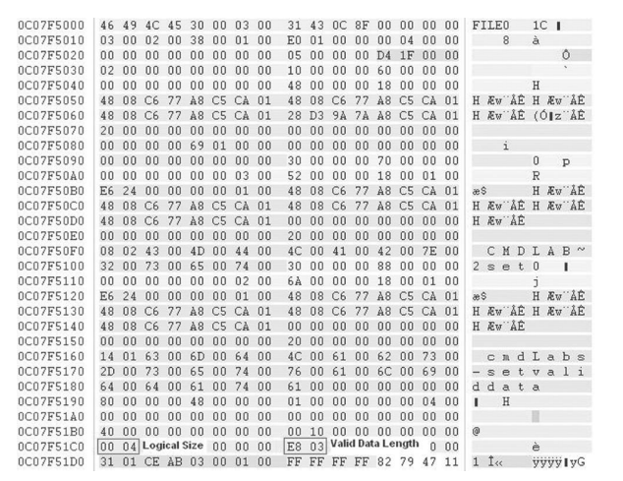
MFT entry with logical size and valid data length viewed using X-Ways Forensics

Slide 17
Next Lecture
Digital Evidences in Windows System
.

